Slide 1
Building a programming course without exams

Slide 2
Motivation.
Too few students were proficient coders at the end of the semester
Many students were too reliant on generative AI.
Some students lacked perseverance.
Basically, I needed students to practice more, and I suspected that too many students were only preparing for the exam.

Slide 3
What I did.
I replaced quarterly exams with weekly quizzes.
Each week students received a list of all possible questions in advance.
Every Friday students were given 3 questions at random.
Each student got a unique random selection.

Slide 4
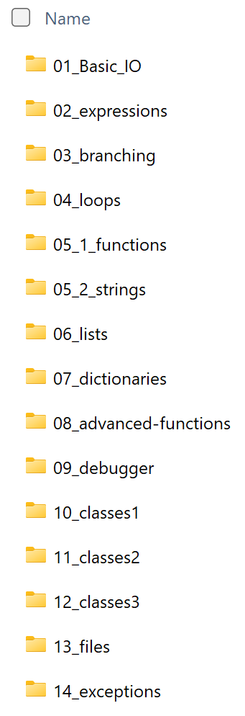
How I did it
I wrote several documents containing questions for each topic.
I wrote python code that generated the 3 random questions.
https://github.com/Matthew-Priem/Quiz-Generator-Into-Programming

Slide 5
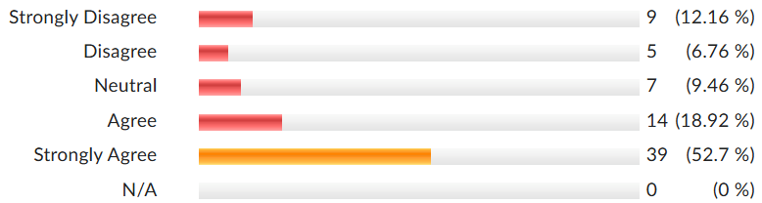
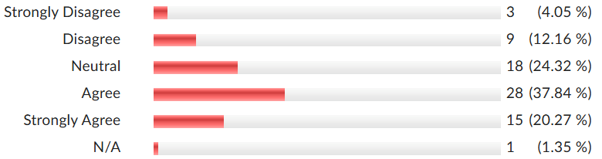
Student’s opinions
I prefer weekly quizzes to quarterly exams
I have been less reliant on generative AI to help me with homework in courses that use weekly quizzes.

Slide 6
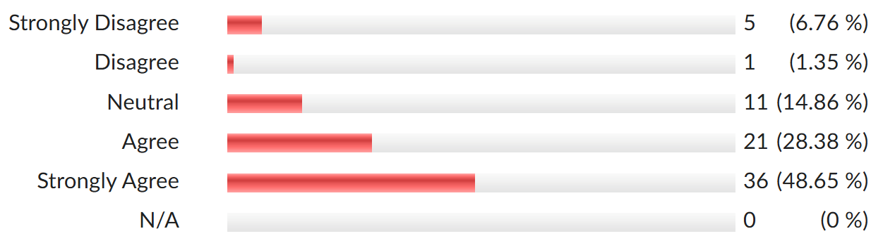
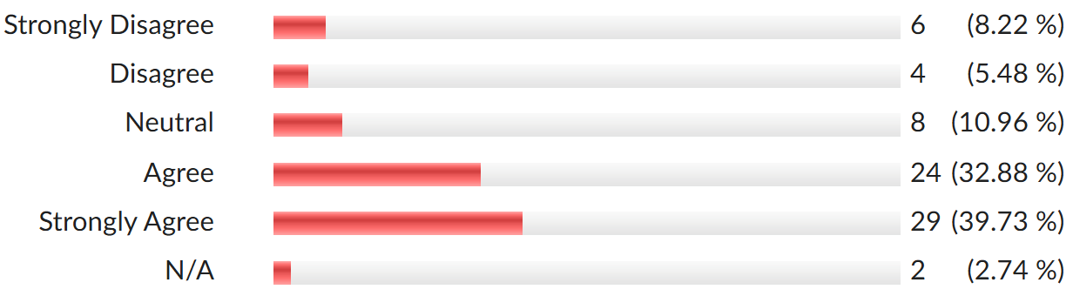
Student’s opinions
I feel that weekly quizzes encourages me to spend more time studying than quarterly exams.
When I have quarterly exams, I do most of my studying in the few days leading up to the exam.

Slide 7
effect on student grades… before retake
Notes:
Interesting note: The Exams (the yellow) included partial credit, while the quizzes did not. It was either right or wrong.

Slide 8
effect on student grades… before retake
Notes:
I added one additional

Slide 9
What I did.
In the previous slide, no partial credit was given to students who took a quiz.
There were 4 quizzes each with 3 questions that scored 0 or 1.
If partial credit were given, the differences between grades were much higher.
Instead of giving partial credit, I chose to give students a second chance in the form of a make up quiz.
That is, there was a make-up quiz at midterms and finals that was uniquely generated for each student dependent on the specific questions they missed.
Each question a student got correct on the make-up, modified the original quiz score
For example…

Slide 10
What do I want students to know? … and when?
Knowledge of Branching and Loops are essential for success in subsequent courses.
It must be mastered before day 1 of data structures.
Does it matter if it was week 4 or week 10 of my course?
Students were given an additional chance to show mastery in the form of a make up quiz.
Once at midterms and once at finals
Uniquely generated for each student dependent on the specific questions they missed.
Each question a student got correct on the make-up, modified the original quiz score
For example…
… not really

Slide 11
For example…
Ashley missed
Matt missed
She will get
- 1 from loops
- 2 from lists
3 will be selected
He will get a pool of 6 random questions (3 each).
5 will be selected.

Slide 12
effect on student grades… after retake

Slide 13
effect on student grades… after retake

Slide 14
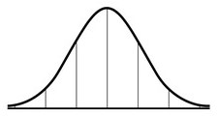
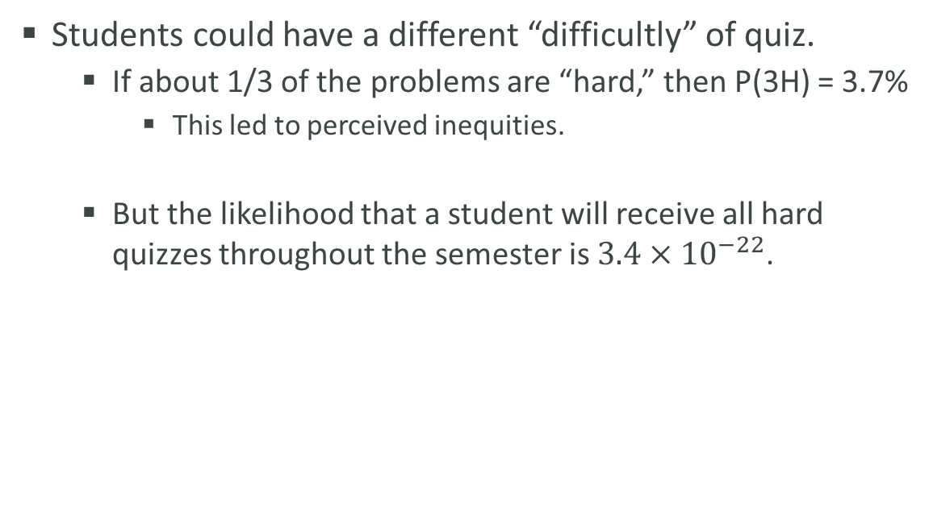
Issues
Students could have a different “difficultly” of quiz.
If about 1/3 of the problems are “hard,” then P(3H) = 3.7%
This led to perceived inequities.
But the likelihood that a student will receive all hard quizzes throughout the semester is $3.4×{10}^{−22}$.
This is a SMALL inequity.
This is a LARGE inequity.
Notes:
about 3/10 of the problems are “hard,” then P(3H) = 0.8%
Purple – no different that having multiple versions of an exam
Green – that is a problem.

Slide 15
Future Plans
Each problem will receive a difficulty classification.
Easy
Medium
Hard
The 3 random problems will include one of each difficulty.

Slide 16
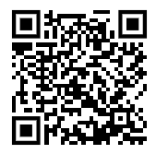
How I did it… with more details and how you can replicate it.
https://github.com/Matthew-Priem/Quiz-Generator-Into-Programming

Slide 17
Additional data…
Notes:
The green has an ABC : DF rate of .75 : .25 The yellow has an ABC : DF rate of .61 : .39

Slide 18
Additional data…
Notes:
The green has an ABC : DFW rate of 67 : 33 The yellow has an ABC : DFW rate of 54 : 46

